Slide 1

SE Mini Project Title
Sustainable Goal:
Píoject Mentoí : Mí Richaíd Joseph
Group Number : 34
Group Members :
Rohit Shahi
Umesh Tolani
Aditya Ajith

Slide 2
Content
Introduction
Problem Definition
Goals/ Objectives
Survey of Existing System
Limitation Existing system or research gap
Details of Hardware & Software
Proposed System: Introduction
Architecture/ Framework (Block Diagram, Conceptual Diagram, ER Diagram)
Algorithm and Process Design
Implementation details(GUI Screenshot, Dataset Used)
Results Obtained
Evaluation Measures
Conclusion and Future Scope
References

Slide 3
Introduction to Project
A schedule management system is a software application that helps users to create, manage, and track schedules. It can be used to manage schedules for a variety of tasks, such as project schedules, meeting schedules, and personal schedules.
Django is a Python framework that is used to develop web applications. It is a popular choice for developing schedule management systems because it is powerful, flexible, and easy to use.

Slide 4
Problem Definition
The current system for managing schedules is not working properly. It is difficult to create and manage schedules, track tasks and resources, and generate reports on schedule progress.

Slide 5
Goals
The goals of the proposed schedule management system are to:
Provide a user-friendly interface for creating and managing schedules.
Track tasks and resources.
Generate reports on schedule progress.
Integrate with other systems, such as email and project management tools.

Slide 6
Literature Survey
There are a number of existing systems that address the same problem. However, they all have limitations.
They are not user-friendly.
They do not have all of the features that are needed to manage schedules effectively.
They are not integrated with other systems.

Slide 7
Limitation of Existing system or research gap
Some of the limitations of existingschedule management
systems include:
They can be expensive, especially the commercial systems
They can be complex to use, especially for non-technical users
They may not be flexible enough to meet the needs of all projects
They may not be able to integrate
with other systems
The proposed system will address the limitations of existing systems by providing a more comprehensive set of features and a more user- friendly interface.

Slide 8



Hardware, Software, Tools and constraint
,
The system will require the following hardware and software: web server, database server, web browser, Django framework, and MySQL database.

Slide 9
Proposed System
The proposed system will be a web-based system that will be developed using the Django framework.
Django is a free and open-source, Python-based web framework that
follows the model–template–views (MTV) architectural pattern.

Slide 10
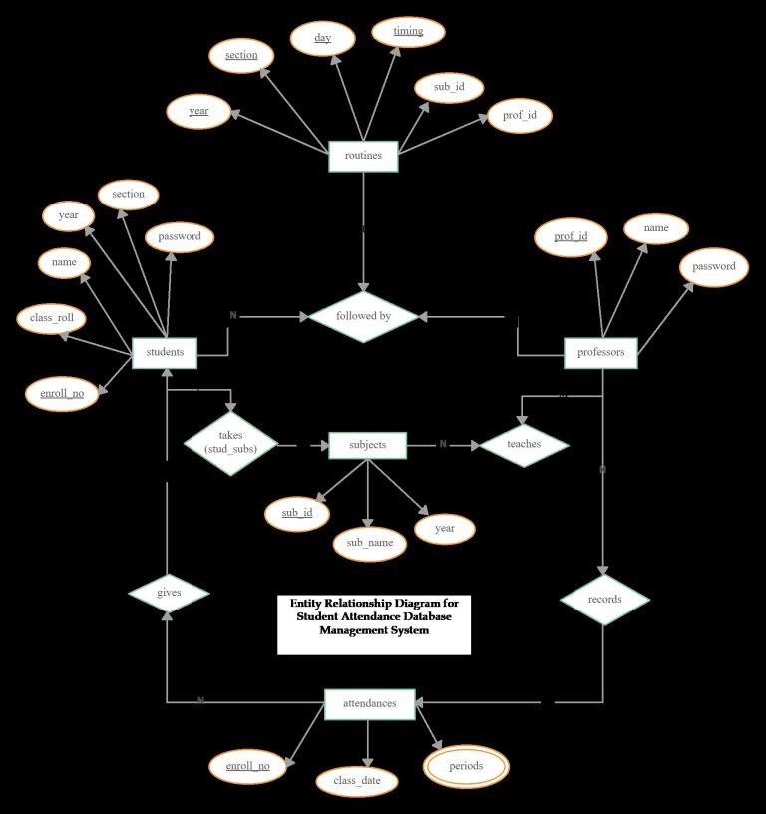
Architecture/ Framework (Block Diagram,
Conceptual Diagram, ER Diagram)
The presentation tier will be responsible for displaying the user interface.
The application tier will be responsible for processing user requests and
storing data.
The data tier will be responsible for storing
data in a database.

Slide 11
Methodology : Algorithm and Process Design
A scheduling algorithm that will be used to create and optimize schedules.
A task tracking algorithm that will be used to track the progress of tasks.
A resource allocation algorithm that will be used to allocate resources to tasks.
A reporting algorithm that will be used to generate reports on schedule progress.

Slide 12
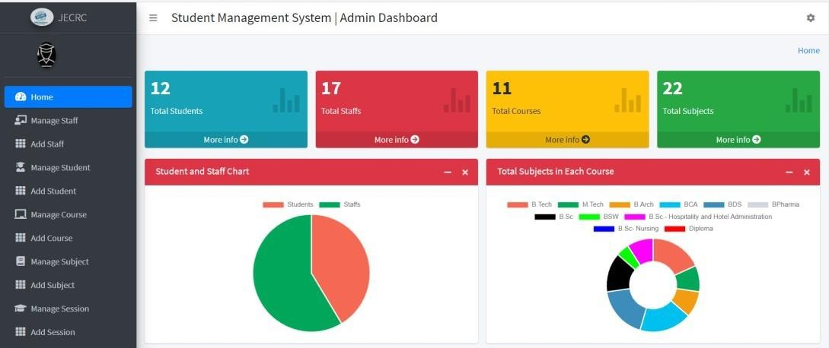
Implementation details(GUI Screenshot, Dataset Used)

Slide 13
Evaluation Measures
Usability measures: | Effectiveness measures: | Efficiency measures:
The number of user errors The time it takes to complete tasks The satisfaction of users with the system The number of features used by users The number of times users need to contact support | The number of schedules created The number of tasks tracked The accuracy of reports generated The number of times the system is used to avoid delays or missed deadlines The number of times the system is used to improve productivity | The amount of time it takes to create a schedule The amount of storage space used by the system The amount of bandwidth used by the system The number of concurrent users that can use the system The number of times the system crashes or experiences errors

Slide 14
Conclusion and Future Scope
The proposed schedule management system will be a valuable tool for managing schedules. It will provide a comprehensive set of features, a user-friendly interface, and integration with other systems.

Slide 15
References
●
Django: https://www.djangoproject.com/
●
MySQL: https://www.mysql.com/

